Slide 1


HETV Regional Business and Finance Training

Slide 2
Freelancer Finances
Pre-viewing in advance of Session 1

Slide 3
MONEY
What do I need to live?
What am I worth?

Slide 4
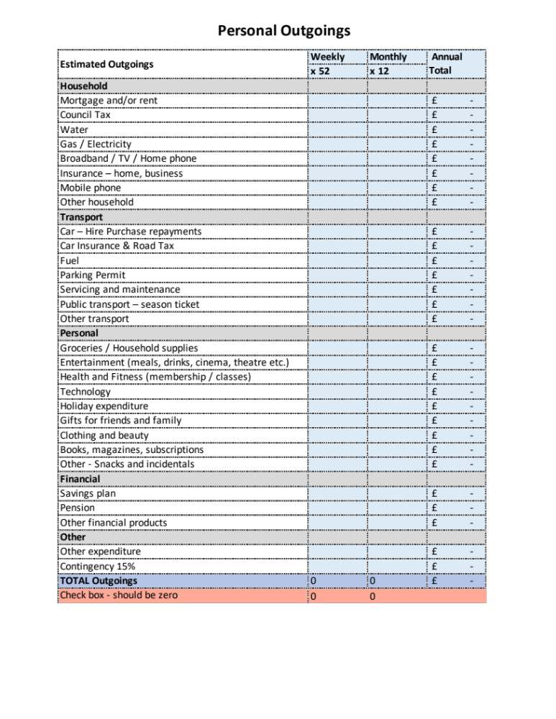

Individual living budget
Knowing what you need to live on
This calculates income AFTER TAX
In UK HMRC ready reckoner
Use to calculate annual Turnover
Informs what you need to charge
Doesn’t tell you your value

Slide 5
Review how much you need to live on
Household
Mortgage
Council tax
Utilities
Transport
Car finance
Public transport
Personal
Groceries
Entertainment
Holidays
Stuff for you
Financial
Savings plan
Loans
Other
School fees
Tools of the Trade
Equipment
Rent
Car running costs
Pension
Medical
Childcare
etc.
Materials
Travel
Subsistence

Slide 6
Managing your money
Business
Current Account
Day to day business transactions
Business
Savings Account
Tax money set aside here
Personal spending
Personal
Current Account

Slide 7
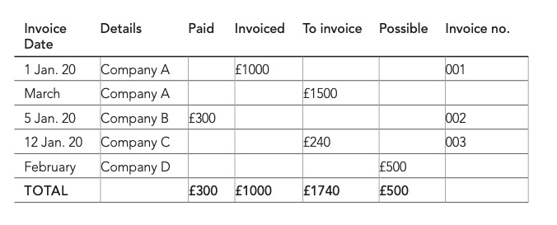
Income spreadsheet

Slide 8

How do I ensure I get paid
Sort the paperwork before you start the work
Ask yourself – does this person have authority to order this?
Get it in writing
  Purchase Order (PO)
  Deal Memo
  Contract
Ensure clarity on the payment schedule
Ensure you get set up as a supplier asap
Understand payment process from client end
  Commercial or public sector?
  Large or small company / production?

Slide 9

Unlocking your value

Slide 10
Value based on estimated rate
Estd annual turnover ➗ estd daily rate = estd no. paid days / year
Example:
£30,000 ➗ £200 = 150 paid days / year
Estd annual turnover ➗ estd weekly rate = estd no. paid weeks / year
Example:
£30,000 ➗ £1000 = 30 weeks / year

Slide 11
Value based on no. working days in year
52 weeks in the year
Assume you take 4 weeks as holiday
Leaves 48 weeks where you could be working
Assume work 5 days per week: 48 × 5 = 240 days
How many of these days will you be doing paid work?
Assume 50% are paid days 24 weeks or 120 days
Estimated annual turnover ➗ 24 = £______ your weekly rate estimate
£30,000 ➗ 24 = £1250 per week
Estimated annual turnover ➗ 120 = £______ your daily rate estimate
£30,000 ➗ 120 = £250 per day

Slide 12
Types of TV contracts

Slide 13
Different types of opportunities in Film and TV
PAYE/Fixed Term Contract (FTC) > 7 days
- likely production roles
PAYE/Fixed Term Contract (FTC) < 7 days
- likely on set / dailies e.g. runner, marshall etc.
Permanent PAYE
- likely non-production / general company roles
Sole Trader
- likely non-entry level roles
Limited Company
- likely HOD and/or those who hire equipment also

Slide 14
Self Assessment for sole traders

Slide 15
UK Sole trader
Financial year
Register as self-employed
Government gateway
Accountants
Tax and National Insurance
Self Assessment
Importance of record keeping
Chargeable expenses

Slide 16
Business expenses
Office supplies, software and equipment
Office repairs, maintenance and alterations
Travel
Clothing
Staff
Things you buy to sell on
Financial
Costs of business premises
Advertising or marketing
Training courses

Slide 17
How tax and NI is calculated
Total Turnover
  Less chargeable expenses
= GROSS Profit
  Less Tax
  Less Class 4 NI
  Less Class 2 NI
= Net Profit
  Your freelance wages come out of here!
Ready reckoner

Slide 18
Tax and NI rates 2025/26
(Tax return due by 31 Jan 2027)
Tax rates
Personal Allowance – first £12,570 at 0% tax
Then next £37,700 at 20% tax (up to £50k)
Then from that £50,271 - £125,140 at 40% tax (after that 45%)
National Insurance
Class 2 – included if profits > £6,725 option to pay - £3.50 per week on profits < £6,725
Class 4 – comes out of Gross Profit
6% on annual profits between £12,571 and £50,270 then 2% on any profit over that amount.

Slide 19


Paying your taxes
You have to make 2 payments every year
Payments are due by midnight on 31st January and 31st July
You will finalise the payments for the tax year you are reporting and pay an advance towards tax owing in the current year
These are called ‘Payments on account’ (50% of your tax bill for the previous year) as estimate for the current year’s tax bill.
Payments on account do not include anything you owe for capital gains or student loans - you’ll pay those in your ‘balancing payment’.

Slide 20
Worked example I
You start self-employment in April 2023.
At the end of your first year of being self-employed (financial year 6th April 2023 – 5th April 2024) you calculate you have a tax bill of £1,800.
The good news is your first tax payment would not be due for payment until 31st January 2025.
The bad news is that this would include a ‘payment on account’ for the current tax year, based on the previous tax year’s bill.
On 31st January 2025 you would be expected to pay:
All the tax for 23/24 and 50% of the tax estimate for 24/25
In this example that would be: £1,800 + £900 = £2,700
Then on 31st July 2025 you would be expected to pay £900 as a payment on account for 24/25.

Slide 21
Worked example II
Moving forwards to the end of your second year of self-employment (6th April 2024 – 5th April 2025) you calculate you have a tax bill of £3,000.
But remember, you made 2 payments on account last year of £900 each (£1,800 in total). So what is due on 31st January 2026?
your ‘balancing payment’ of £1,200 for the 24/25 tax year (£3,000 minus £1,800) plus
the first payment on account of £1,500 (half your 24/25 tax bill) towards your 25/26 tax bill
Therefore, the total tax to pay by midnight on 31st January 2026 is £2,700.
You have to pay your second payment on account of £1,500 by midnight on 31st July 2026.

Slide 22
Making Tax Digital – Started April 2026
Submit quarterly updates with summary of transactions
Quarter 1 (6 Apr – 5 Jul): Update due by 7 August
Quarter 2 (6 Jul – 5 Oct): Update due by 7 November
Quarter 3 (6 Oct – 5 Jan): Update due by 7 February
Quarter 4 (6 Jan – 5 Apr): Update due by 7 May
Final end of year declaration due by 31st January as usual
Tax and NI payments due by January 31st and July 31st as usual
When you start depends on your qualifying income:
£50,000 for the 24/25 tax year, you will need to use it from 6 April 2026
£30,000 for the 25/26 tax year, you will need to use it from 6 April 2027
£20,000 for the 26/27 tax year, you will need to use it from 6 April 2028

Slide 23
Student Loans
Amount repayable depends on your plan
For ‘annual salary’ read total income for the year
Does total income go over annual salary threshold?
E.g. Plan 2 loans start paying back when total income > £28,470 at 9%.
E.g. Post graduate loans > £21,000 at 6%
Calculated as:
(Annual Income – threshold) x 9% = Total payable
E.g. Plan 2 (£32,000 - £28,470) x 9% = £317.70 for the year
E.g. Post grad (£32,000 - £21,000) x 6% = £660 for the year

Slide 24
VAT
Current VAT rate 20%
Threshold £90,000 turnover (not profit)
Can register voluntarily
Flat rate scheme for small businesses (<£150k)

Slide 25
Pensions
Your responsibility to organise as a freelancer
Hard to calculate regular payment amount
May want to opt for irregular lump sum payments
Take professional advice
If working on contracts longer than 3 months entitled to opt in to company scheme
  Some potential to do this from day one – again take advice
Increasingly companies looking to support freelance pensions with more flexible payments

Slide 26
Thank you!

Slide 27

Freelance mindset
Secure in insecurity
Feast and famine
Risk profile
Work - life balance
It’s OK to say no
You have you look out for you

Slide 28
Valuation tools
Experience in the role
Just started (<1 year)
Early stage (1-3 years)
Mid-career (3-5 years)
Experienced (5+ years)
benchmarking
Sector resources
Published opportunities
Asking people
Industry sector variations
Commercial or not for profit
Teaching or doing
Large or small company / production
Intended audience for your work
Pitch work
Speculative
Revenue generating

Slide 29
Valuation analysis
Valuation Analysis | Research | Estimated rate
What do I need to earn to live? | Valuation based on estimated rate
 | Valuation based on no. of working days in year
Experience | My experience level is…
Benchmarking | Sector resources
 | Published opportunities
 | Asking people
Sector variations | I will deliver services in these sectors
Intended audiences | Variations in intended audience are

Slide 30


Mechanics of freelANCING
UK specific download available at alisongrade.com in partnership with IPSE
Insurance
Legal

Slide 31
How do I put my prices up?
1. Tell your clients you are going to put your prices up
2. Then, put your prices up
3a. Client agrees
Everyone happy
3b. Client doesn’t agree
Carry on as before
Walk away.

Slide 32
Overpricing
Indicators:
Insufficient work
Proposals don’t convert to meetings
Meetings don’t convert to work
Questions:
Are you pricing too high?
Do clients understand your offering?
Do clients value your offering?
Indicators:
Questions:
Too good value?
Too much work
Everyone wants a piece of you
Have you asked for a higher rate?
Underpricing

Slide 33

Different ways you can add value
Much more than trading time for money
doing that voodoo that you do so well…..
Fulfill a need for your client
Develop new opportunities for your client
Increase sales for your client
Save ££ on the bottom line for your client

Slide 34

Sharp intake of breath test
When a client asks you how much a project will cost, you tell them and you don’t hear a sharp intake of breath
then ...
you’ve under-priced the work

